Slide 1
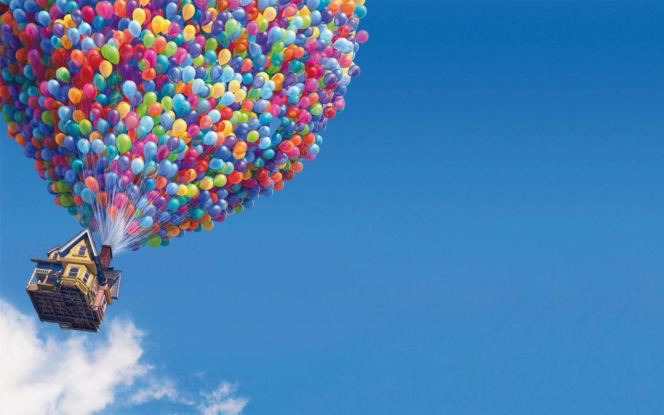
Predicting Revenue for Animation Films
Tiffany Li

Slide 2
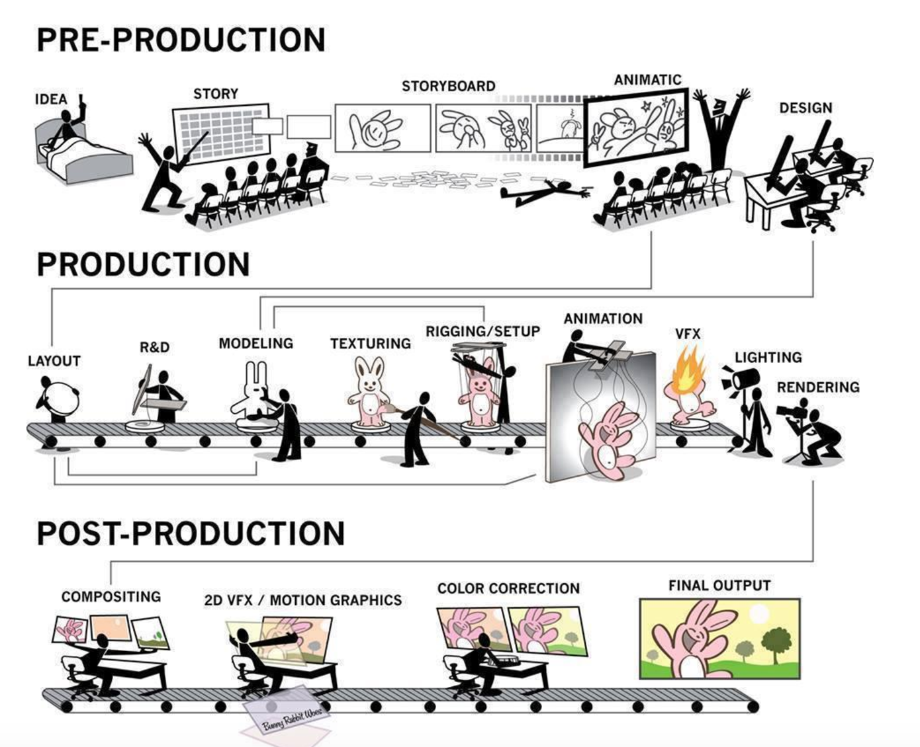
Motivations
The process for producing animation films is long, complex and expensive
Joint efforts of up to 500 talents
What are the keys to success?

Slide 3
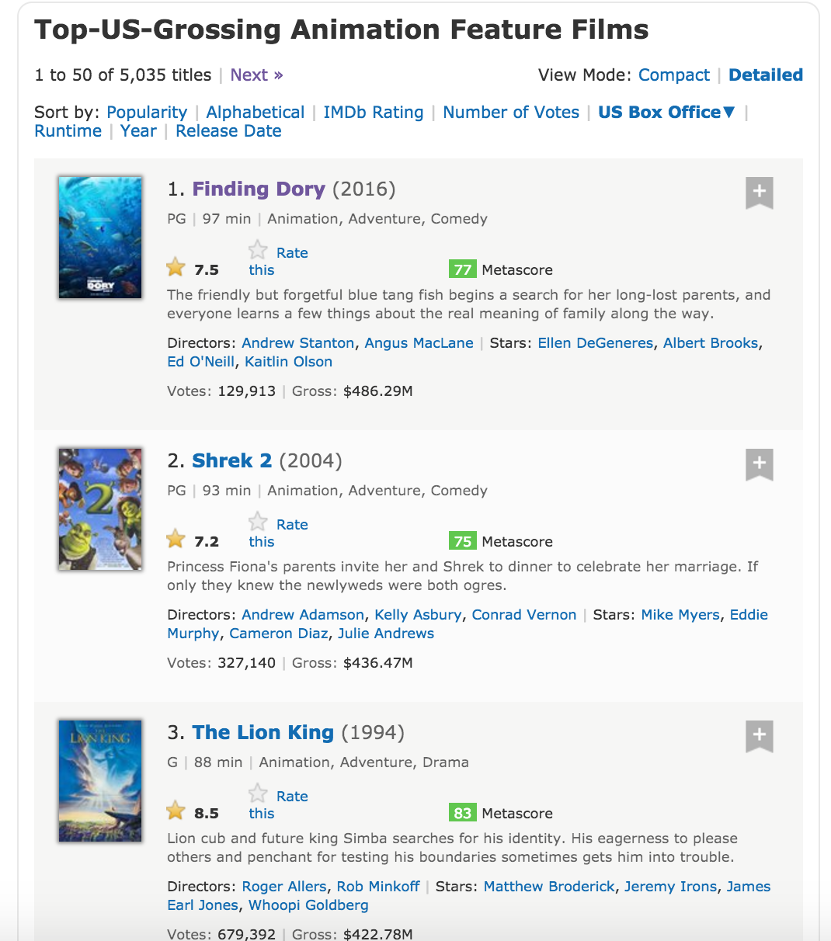
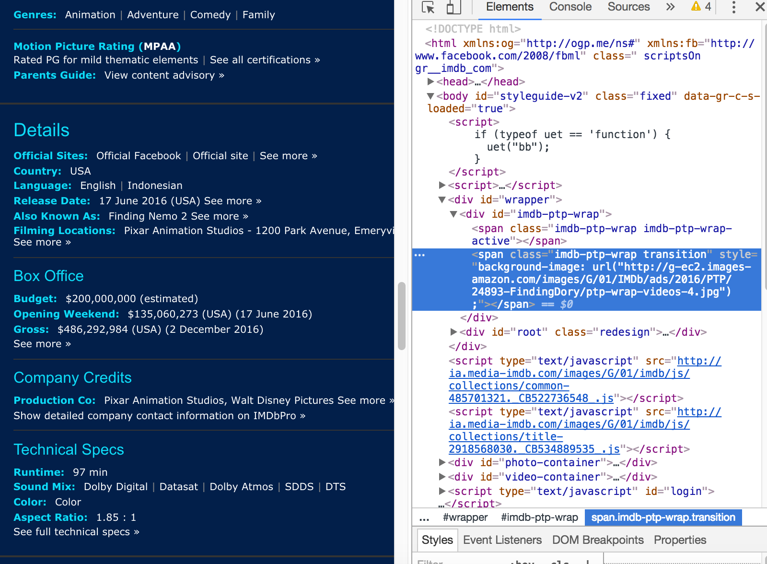
Web Scraping
Data collected from imdb.com

Slide 4
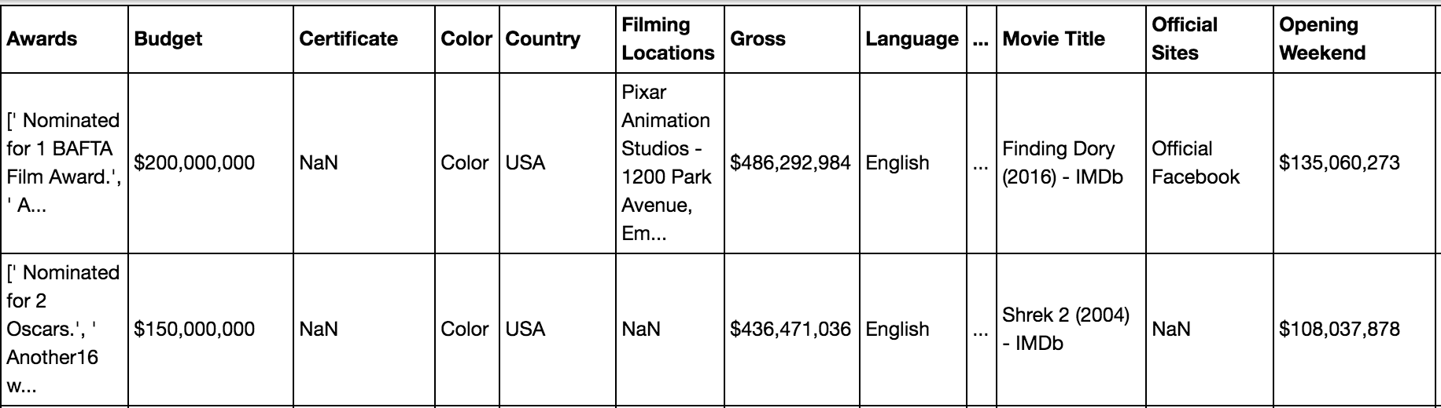
Data Processing
Using beautiful soup, scraped features for top 400 animation films, including movie title, budget, country, MPAA rating, opening weekend gross, production co, IMDB rating score, release date, runtime and awards.

Slide 5
Feature Engineering
Dropped data outside of US or earlier than 1990
Categorized movies into ‘won awards’, ‘nominated’ or ‘not’
Categorized production companies into large, medium and small based on total gross revenue
Extracted year, month, day, day of the week and date ordinal
Filled in missing value with median
223 data points as input

Slide 6
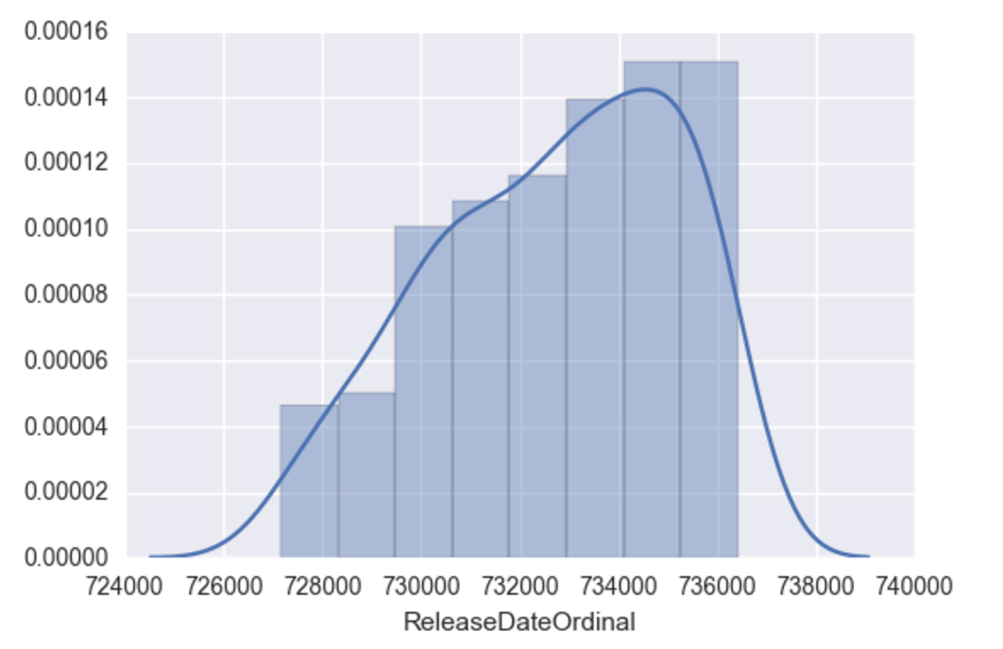
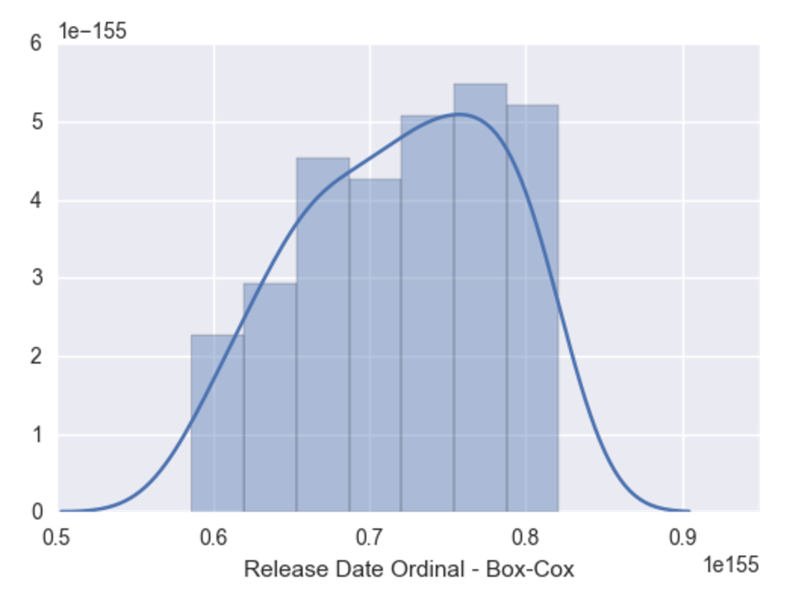
Box-Cox Transformation

Slide 7
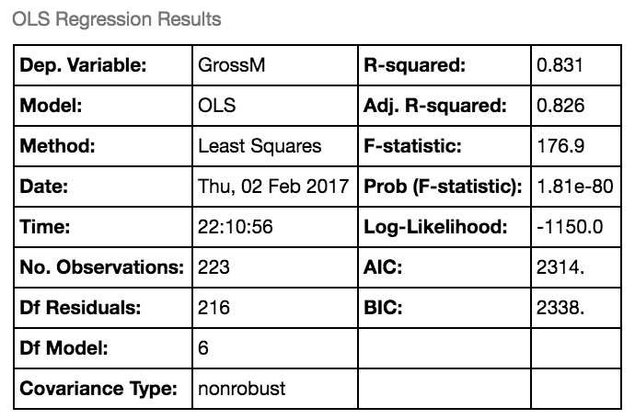
Finding the Best Model
Used simply linear regression to compare effectiveness by adding/dropping variables
Found the best predictor variables to be opening weekend, rating score, release date ordinal, awards results and production company size.

Slide 8
Regularization
Compared cross validated Lasso, Rigid and Elastic Net models
Cross validated Elastic Net model produced the best mean squared error
Alpha = 0.17
R squared = 0.878

Slide 9
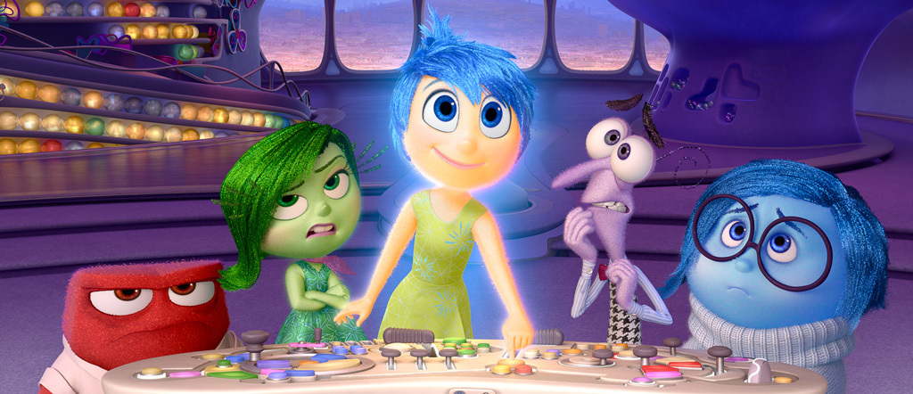
Predictive Model
Gross Revenues Equals to
96 + 62 ∗ Opening Weekend + 14 ∗ Rating Score + 0.0 ∗ Release Date Ordinal + 4 ∗ Nominated + 42 ∗ Won + 21 ∗ Large − 23 ∗ Small
Example: Inside out
Model predicts: 340M

Slide 10

Predictive Model
Gross Revenues Equals to
96+62 ∗ Opening Weekend + 14 ∗ Rating Score + 0.0 ∗ Release Date Ordinal + 4 ∗ Nominated + 42 ∗ Won + 21 ∗ Large − 23.4 ∗ Small
Example: Inside out
Model predicts: 340M
Actual: 356M

Slide 11
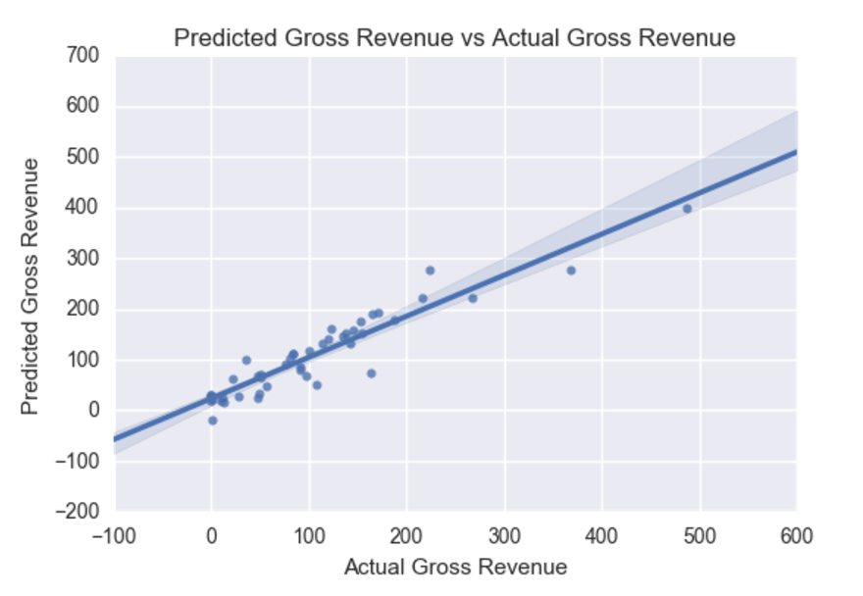

Slide 12
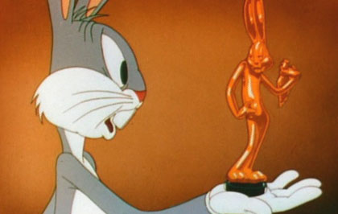
Implications
What’s important?
Opening Weekend
First impression matters! Put out more commercials
IMDB Rating Score
Get that ‘critically acclaimed’ stamp
Awards
Oscar, here I come…
Production Company Size
Big studios still got the edge

Slide 13

Implications
What’s not worth it:
Budget
Maybe don’t spend 6 months making a snowflake?
Release Date Month / Quarter
Christmas doesn’t guarantee the presents
MPAA Rating
G or PG? Does not matter
In an effort to perfect Elsa’s icy magic in Frozen, filmmakers called on Dr. Thomas Painter to learn about snowflakes from a molecular level.

Slide 14
Further Investigations
More feature engineering
Break down the awards into different levels
Incorporate data from other sources
Fill in missing values with actual values
Other rating metrics
Impact of 3D movies
Does the popularity of the voice over cast matter?

Slide 15
